Slide 1


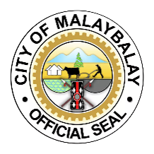
RETROSPECTIVE RESEARCH
Drowning Incident-Malaybalay City
2019-2025 under the WHO ICD 10 Reporting Template
Conducted in 46 Barangay consolidated by 460 respondents
facilitated by 45 CBMS
12-22 July 2026
Malaybalay City - DRRM Office

Slide 2
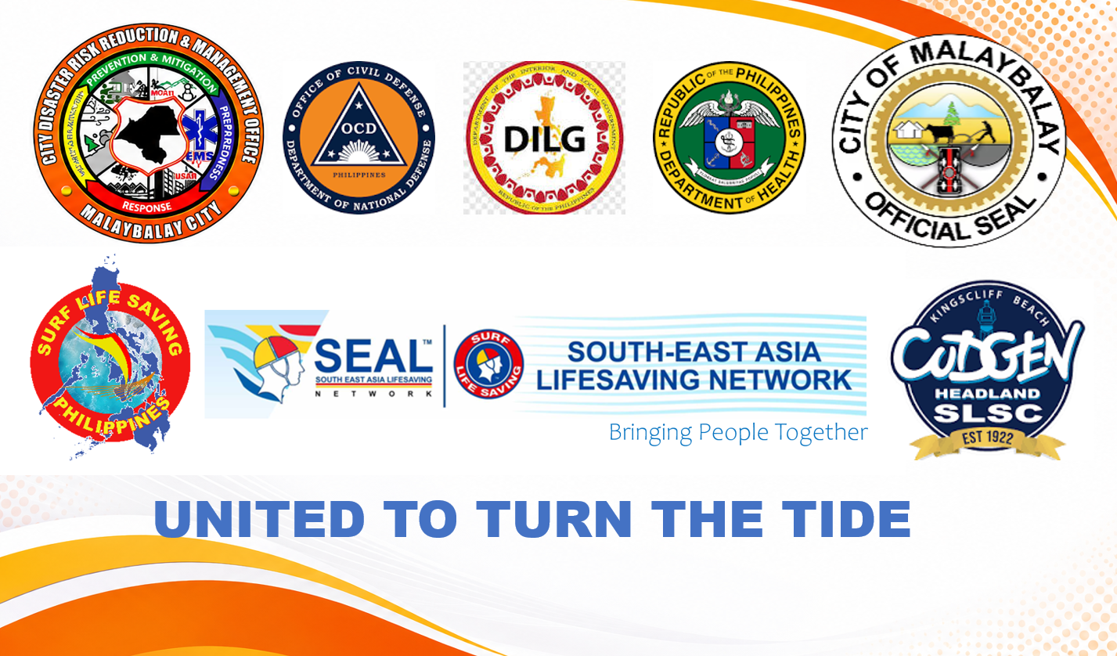

Slide 3

Retrospective Survey on Drowning Incidents (2019–2025)
Summary of Results from 46 Barangays City Disaster Risk Reduction and Management Office (CDRRMO) – Malaybalay City

Slide 4
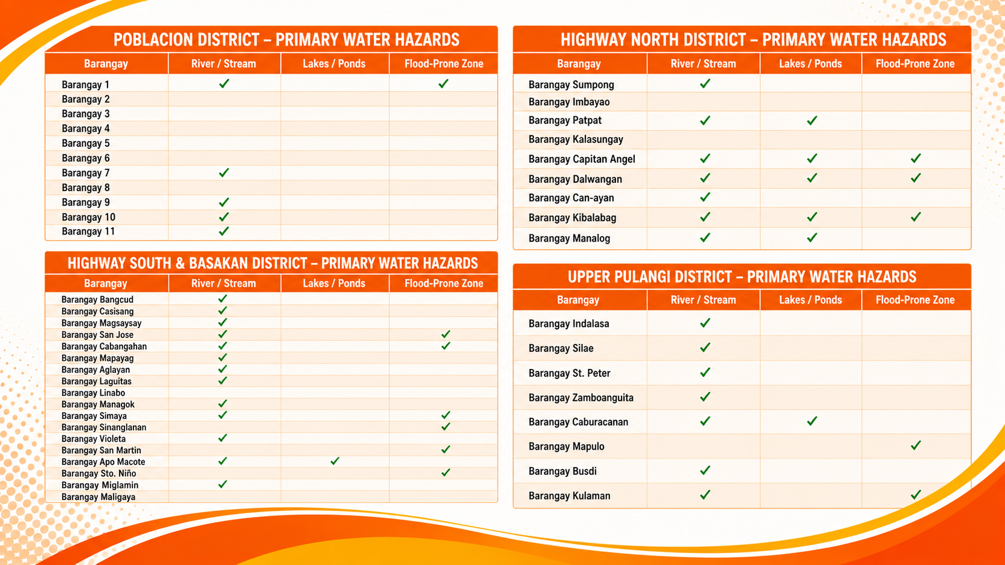

Slide 5

Case Overview
22 total drowning cases recorded, 2019–2025
22
19
82%
82%
Total cases
Fatal
Male victims
Cases with
no CPR given
What the data shows
Rivers are the dominant setting, accounting for 68% of all cases.
Children (10–14) and young adults (20–29) are the most affected age groups.
Emergency response is a critical gap — CPR was administered in only 4 of 22 cases.

Slide 6
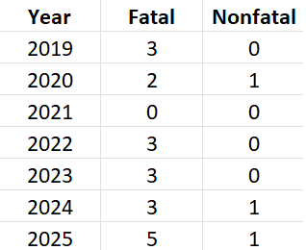
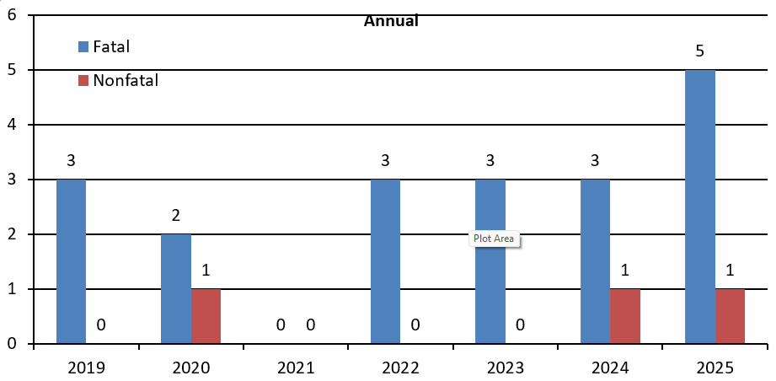

Slide 7
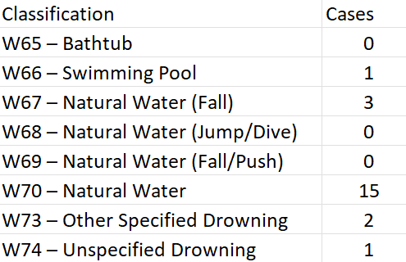
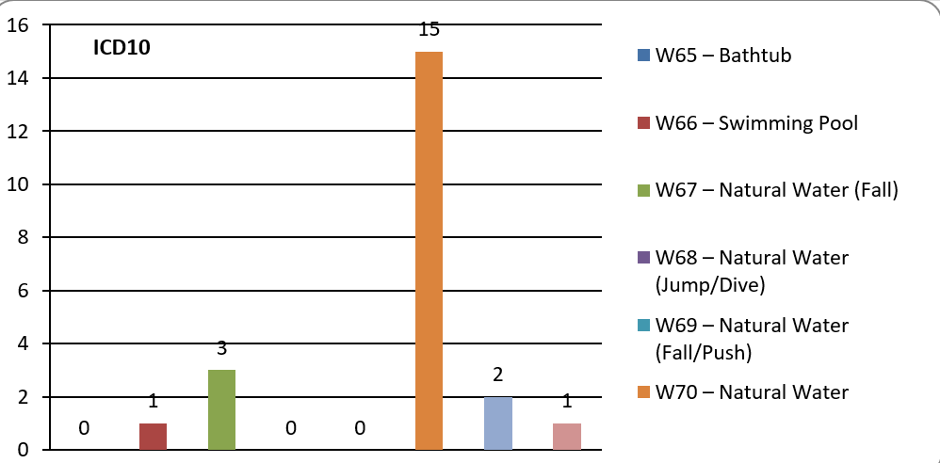

Slide 8
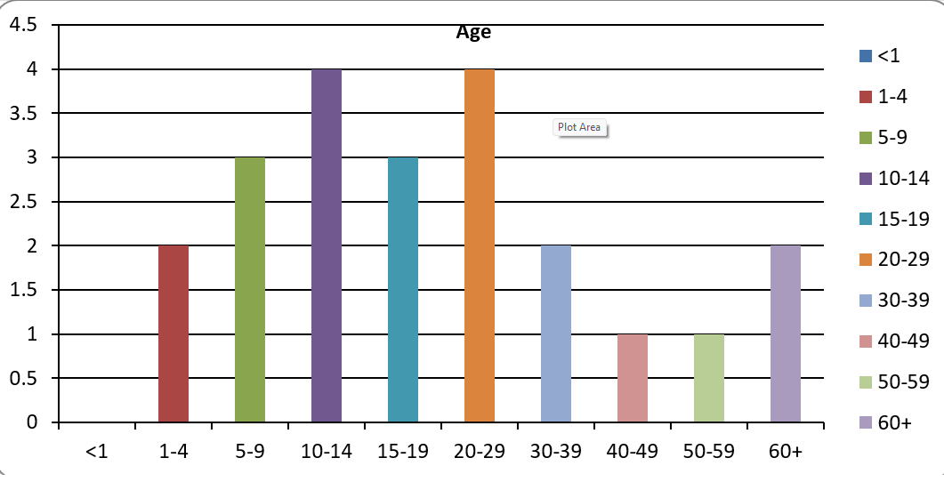
Who Is Most Affected
Age and gender distribution among recorded cases
Males account for 77% of recorded cases; ages 30+ and 5–14 are the most represented groups. One case involved a physically challenged individual.

Slide 9
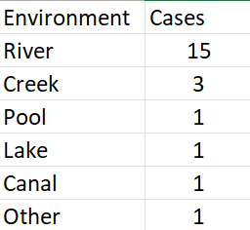
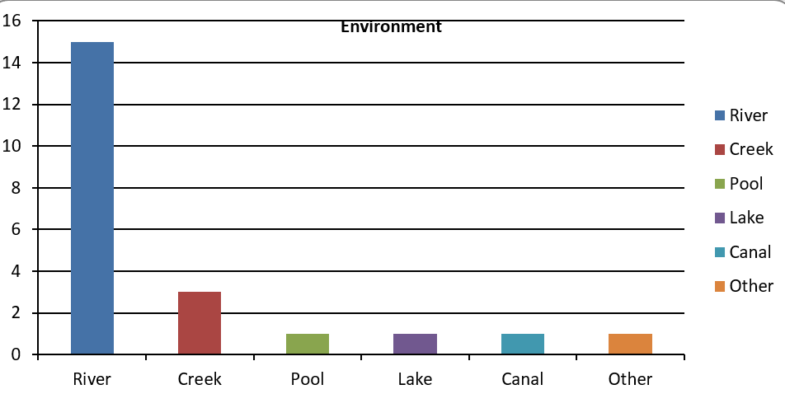

Slide 10
A Critical Gap in Emergency Response
CPR administration and PWD involvement
Only 18% of cases received bystander or first-responder CPR — the single largest preventable gap in this dataset.

Slide 11
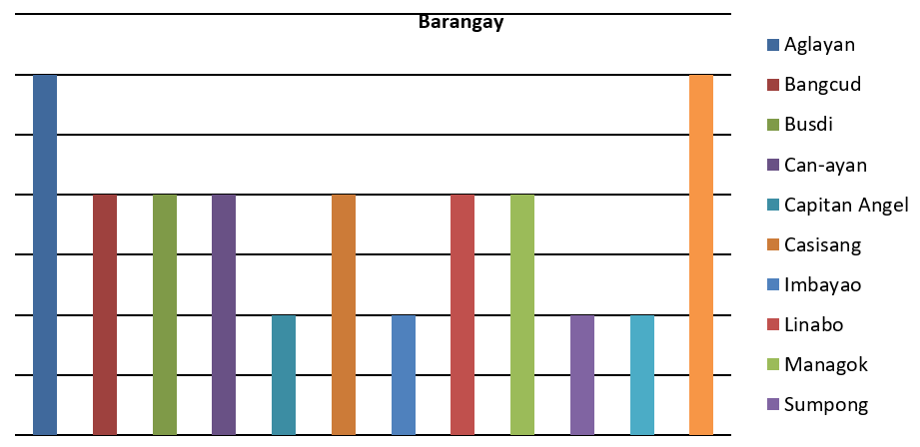
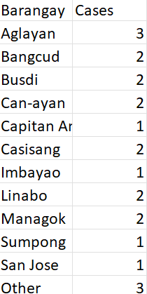
Case Hotspots by Barangay
Recorded cases by barangay of occurrence (n=22)

Slide 12
Recommendations
1. Target river safety directly
2. Reach children and young adults
3. Close the CPR gap
Install signage, barriers, and rescue equipment at high-risk river segments — rivers account for 68% of cases.
Deliver water-safety education through schools for ages 10–14, and community outreach for young adults 20–29.
Roll out community bystander-CPR and basic water rescue training; only 18% of cases had CPR administered.
4. Engage male-focused messaging
5. Focus on hotspot barangays
6. Plan for inclusive rescue access
Design outreach for men and boys (82% of cases), who are likely exposed through fishing, labor, or recreation near water.
Prioritize Aglayan and the cluster of barangays with repeat cases (Bangcud, Busdi, Can-ayan, Casisang, Linabo, Managok) for local interventions.
Ensure warning systems and rescue equipment account for PWD residents near water-risk areas.

Slide 13
THANK YOU

